Slide 1

Arithmetic and Logic
Chapter 5
The AVR microcontroller
and embedded
systems
using assembly and c

Slide 2
Topics
Arithmetic instructions
Logic and compare instructions
Rotate and shift instructions and data serialization
BCD and ASCII conversion

Slide 3
Arithmetic instructions – summary
Addition:
  ADD, ADC, ADIW
Subtraction:
  SUB, SBC, SBCI, SBIW
Increment/Decrement: INC, DEC
Multiplication:
  MUL, MULS, MULSU, FMUL, FMULS, FMULSU

Slide 4
Data Processing: Arithmetic-ADD
Add without carry: ADD Rd, Rr
Rd ← Rd + Rr where 0 ≤ d ≤ 31 , 0 ≤ r ≤31
Adds two registers without the C flag and places the result in the destination register Rd.
Flags affected : H, S, V, N, Z, C
CPU Cycle : 1
  Example :
ADD R1, R2 ;ADD R2 to R1 (r1 ← r1+r2)
ADD R28,R28 ;ADD R28 to itself (R28 ← R28 + R28)
Module 4/<number>

Slide 5
Data Processing: Arithmetic-ADD
Show the status of the C, H and Z flags after the addition of 0x38 and 0x2F in the following instructions:
LDI R16, 0x38
LDI R17, 0x2F
ADD R16, R17
Solution:
 | $38 |  | 0011 1000
+ | $2F |  | 0010 1111
R16 | $67 |  | 0110 0111
R16 = 0x67
C = 0 because there is no carry beyond the bit7
H = 1 because there is a carry from the bit 3 to bit 4
Z = 0 because the R16 (the result) has a value other than 0 after the addition.
20112012-I
Module 4/<number>

Slide 6
Data Processing: Arithmetic-ADD
Show the status of the C, H and Z flags after the addition of 0x9C and 0x64 in the following instructions:
LDI R20, 0x9C
LDI R21, 0x64
ADD R20, R21 ;add R21 to R20
Solution:
 | $9C |  | 1001 1100
+ | $64 |  | 0110 0100
R20 | $100 |  | 0000 0000
R20 = 0x00
C = 1 because there is a carry beyond the bit7
H = 1 because there is a carry from the bit 3 to bit 4
Z = 1 because the R20 (the result) has a value of 0 after the addition.

Slide 7
Data Processing: Arithmetic-ADC
Add with carry: ADC Rd, Rr
  Rd ← Rd + Rr +C where 0 ≤ d ≤ 31 , 0 ≤ r ≤31
Adds two registers and the contents of the C flag and places the result in the destination register Rd
Flags affected : H, S, V, N, Z, C
CPU Cycle : 1
  Example : (Add R1:R0 to R3:R2)
ADD R2, R0 ;Add low byte
ADC R3, R1 ;Add with carry high byte

Slide 8
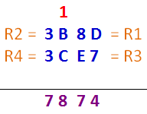
Data Processing: Arithmetic-ADC
Write a program to add two 16-bit numbers. The numbers are $3CE7 and $3B8D. Assume that R1 = $8D, R2 = $3B, R3 = $E7, and R4 = $3C. Place sum in R3 and R4; R3 should have the lower byte
Solution:
    ADD R3, R1
    ADC R4, R2
Notice: Use ADD for lower byte and ADC for the higher byte

Slide 9
Data Processing: Arithmetic-ADIW
Add immediate to word: ADIW Rd+1:Rd, K
  Rd+1:Rd ← Rd+1:Rd + K where d ∈ {24,26,28,30}, 0 ≤ K ≤ 63
Adds an immediate value (0-63) to a register pair and places the result in the register pair.
This instruction operates on the upper four register pairs, and is well suited for operations on the pointer registers.
Flags affected : S, V, N, Z, C
CPU Cycle : 2
  Example :
ADIW R25:R24, 1 ;Add 1 to R25:R24
ADIW ZH:ZL, 63 ;Add 63 to the Z-pointer (R31:R30)

Slide 10
Data Processing: Arithmetic-ADIW
LDI ZL, 13
LDI ZH, 53
ADIW R31:R30, 26
13 is added to ZL
If the result is > 255 the carry bit is set, and ZH incremented by 1
If ZH is > 255, the carry bit in the SREG is set
Solution
  ZL = 13 = 0b 0000 1101
  ZH = 53 = 0b 0011 0101
After adding 26 = 0b 0001 1010
  ZL = 13 + 26 = 39 = 0b 0010 0111 is < 255, the carry bit will not set
  ZH = 53 = 0b 0011 0101 unchanged and the carry bit in SREG is not set

Slide 11
Data Processing: Arithmetic-SUB
Subtract without carry: SUB Rd, Rr
  Rd ← Rd – Rr where 0 ≤ d ≤ 31 , 0 ≤ r ≤31
Subtracts two registers and places the result in the destination register Rd
Flags affected : H, S, V, N, Z, C
CPU Cycle : 1
  Example :
SUB R13, R12 ;Subtract r12 from r13

Slide 12
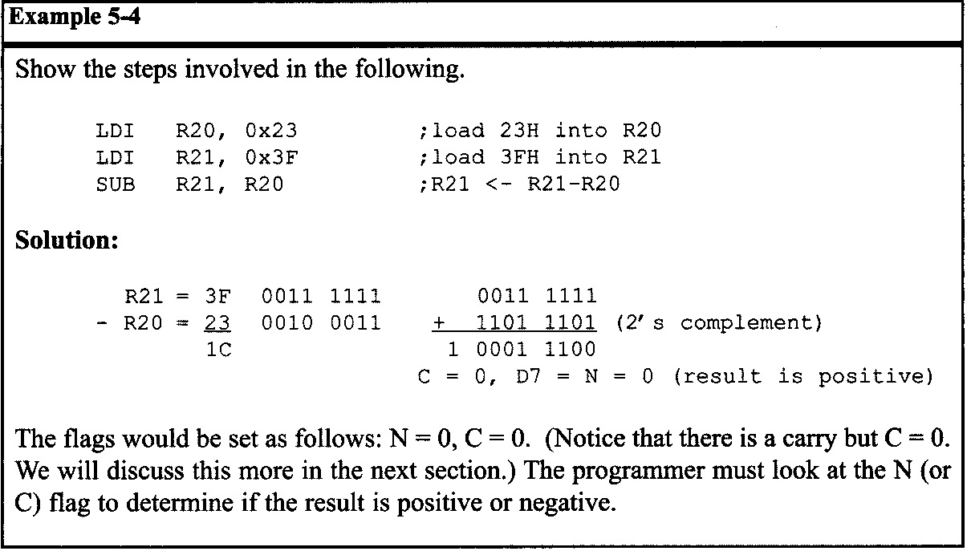
Data Processing: Arithmetic-SUB

Slide 13
Data Processing: Arithmetic-SUBI
Subtract Immediate: SUBI Rd, K
  Rd ← Rd – K where 16 ≤ d ≤ 31 , 0 ≤ K ≤ 255
Subtract a register and a constant and places the result in the destination register Rd.
This instruction works on register R16 to R31 and is very well suited for operations on the X, Y and Z pointers.
Flags affected : H, S, V, N, Z, C
CPU Cycle : 1
  Example :
SUBI R13, $11 ;Subtract $11 from R13

Slide 14
Data Processing: Arithmetic-SBC
Subtract with carry: SBC Rd, Rr
  Rd ← Rd – Rr – C where 0 ≤ d ≤ 31 , 0 ≤ r ≤31
Subtracts two registers and subtracts with the C flag and places the result in the destination register Rd.
Flags affected : H, S, V, N, Z, C
CPU Cycle : 1
  Example : (Subtract r1:r0 from r3:r2)
SUB R2, R0 ;Subtract low byte
SBC R3, R1 ;Subtract with carry high byte

Slide 15
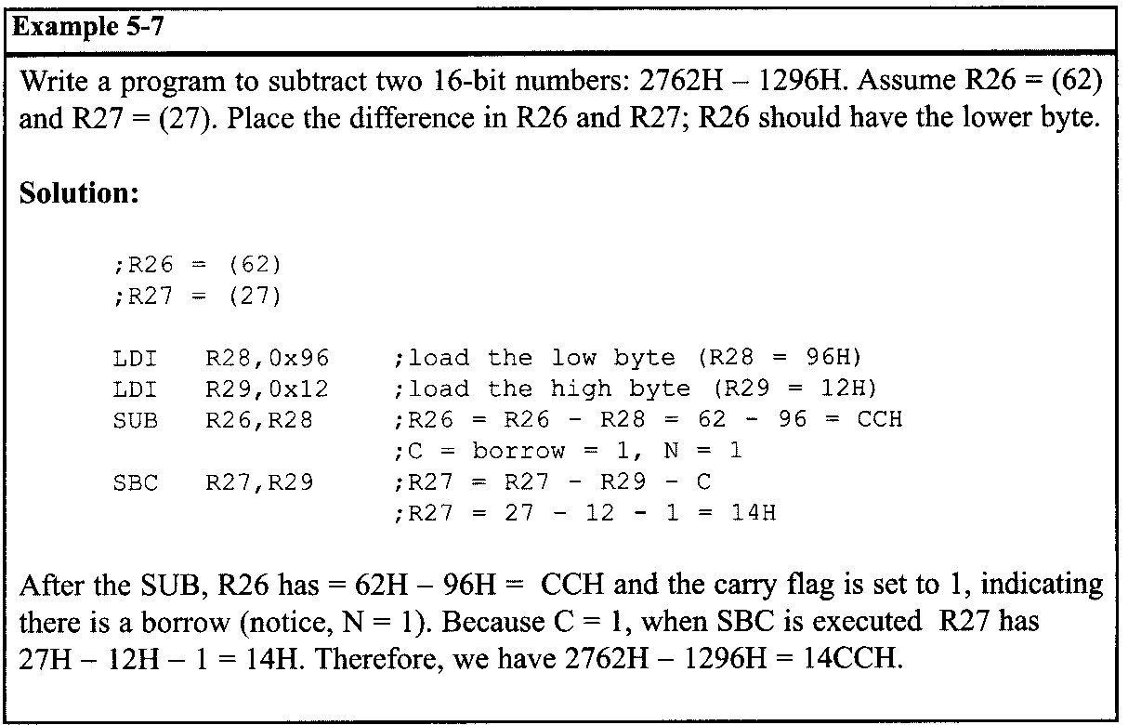
Data Processing: Arithmetic-SBC

Slide 16
Data Processing: Arithmetic-SBCI
Subtract immediate with carry: SBCI Rd, K
  Rd ← Rd – K – C where 0 ≤ d ≤ 31 , 0 ≤ K ≤ 255
Subtracts a constant from a register and subtracts with the C flag and places the result in the destination register Rd.
Flags affected : H, S, V, N, Z, C
CPU Cycle : 1
  Example : Subtract $4F23 from r17:r16
SUB R16, $23 ;Subtract low byte
SBCI R17, $4F ;Subtract with carry high byte

Slide 17
Data Processing: Arithmetic-SBIW
Subtract immediate from word: SBIW Rd+1:Rd, K
  Rd+1:Rd ← Rd+1:Rd – K where d ∈ {24,26,28,30}, 0 ≤ K ≤ 63
Subtracts an immediate value (0-63) from a register pair and places the result in the register pair.
This instruction operates on the upper four register pairs, and is well suited for operations on the pointer registers.
Flags affected : S, V, N, Z, C
CPU Cycle : 2
  Example :
SBIW R25:R24, 1 ;Subtract 1 from r25:r24
SBIW YH:YL, 63 ;Add 63 to the Y-pointer

Slide 18
Data Processing: Arithmetic-INC
Increment: INC Rd
  Rd ← Rd + 1 where 0 ≤ d ≤ 31
Adds one to the contents of register Rd and places the result in the destination register Rd.
The C flag in SREG is not affected by the operation, thus allowing the INC instruction to be used on a loop counter in multiple-precision computations.
Flags affected : S, V, N, Z
CPU Cycle : 1
  Example :
LDI R22, $19 ; move $19 to R22 (R22=$19)
INC R22 ; increment R22 (R22=$1A)

Slide 19
Data Processing: Arithmetic-DEC
Decrement: DEC Rd
  Rd ← Rd – 1 where 0 ≤ d ≤ 31
Subtracts one from the contents of register Rd and places the result in the destination register Rd.
The C flag in SREG is not affected by the operation, thus allowing the DEC instruction to be used on a loop counter in multiple-precision computations.
Flags affected : S, V, N, Z
CPU Cycle : 1
  Example :
LDI R22, $19 ; move $19 to R22 (R22=$19)
DEC R22 ; decrement R22 (R22=$18)

Slide 20
Data Processing: Arithmetic-DEC
Show the status of the Z flag during the execution of the following program:
LDI R20, 4 ;R20 = 4
DEC R20 ;R20 = R20 -1
DEC R20 ;R20 = R20 -1
DEC R20 ;R20 = R20 -1
DEC R20 ;R20 = R20 -1
Solution:
The Z flag is one when the result is zero. Otherwise, it is cleared (zero). Thus:
After | Value of R20 | The Z flag
LDI R20, 4 | 4 | 0
DEC R20 | 3 | 0
DEC R20 | 2 | 0
DEC R20 | 1 | 0
DEC R20 | 0 | 1

Slide 21
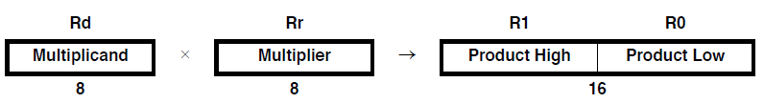
Data Processing: Arithmetic-MUL
Multiply unsigned: MUL Rd, Rr
  R1:R0 ← Rd x Rr (unsigned ← unsigned x unsigned) where 0 ≤ d ≤ 31 , 0 ≤ r ≤ 31
This instruction performs 8bit x 8 bit → 16bit unsigned multiplication.
The multiplicand Rd and the multiplier Rr are two registers containing unsigned numbers.
The 16 bit unsigned product is placed in R1(high byte) and R0(low byte).
Flags affected : Z, C
CPU Cycle : 2
  Example :
MUL R5, R4 ;Multiply unsigned R5 and R4
MOV R5, R1
MOV R4, R0 ;Copy result back in R5:R4

Slide 22
Data Processing: Arithmetic-MULS
Multiply signed: MULS Rd, Rr
  R1:R0 ← Rd x Rr (signed ← signed x signed)
  where 16 ≤ d ≤ 31 , 16 ≤ r ≤ 31
This instruction performs 8bit x 8 bit → 16bit signed multiplication.
The multiplicand Rd and the multiplier Rr are two registers containing signed numbers.
The 16 bit signed product is placed in R1(high byte) and R0(low byte).
Flags affected : Z, C
CPU Cycle : 2
  Example :
MULS R5, R4 ;Multiply signed R5 and R4
MOVW R5:r4, R1:R0 ;Copy result back in R5:R4

Slide 23
Data Processing: Arithmetic-MULSU
Multiply signed with unsigned: MULSU Rd, Rr
R1:R0 ← Rd x Rr (signed ← signed x unsigned) where 16 ≤ d, r ≤ 31
This instruction performs 8bit x 8 bit → 16bit signed multiplication of a signed and an unsigned number.
The multiplicand Rd and the multiplier Rr are two registers.
The multiplicand Rd is a signed number and the multiplier Rr is unsigned.
The 16 bit signed product is placed in R1(high byte) and R0(low byte).
Flags affected : Z, C
CPU Cycle : 2
  Example :
MULSU R5, R4 ;Multiply signed R5 and unsigned R4
MOVW R5:R4, R1:R0 ;Copy result back in R5:R4

Slide 24
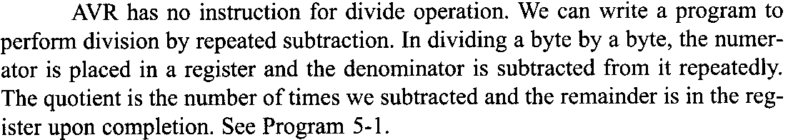
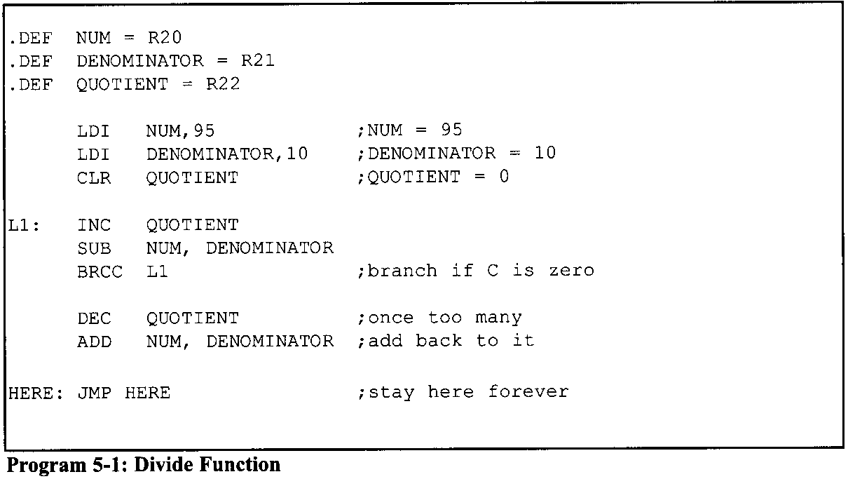
Data Processing: Arithmetic-Division

Slide 25
An application for division
Sometimes a sensor is connected to an ADC (analog-to-digital converter) and the ADC represents some quantity such as temperature or pressure. The 8-bit ADC provides data in hex in the range of 00-FFH. This hex data must be converted to decimal. We do that by dividing it by I 0 repeatedly, saving the remainders, as shown in Examples 5-8 and 5-9.
Example 5-8
Assume that the data memory location 0x315 has value FD (hex). Write a program to convert it to decimal. Save the digits in locations 0x322, 0x323, and 0x324, where the least-significant digit is in location 0x322.

Slide 26
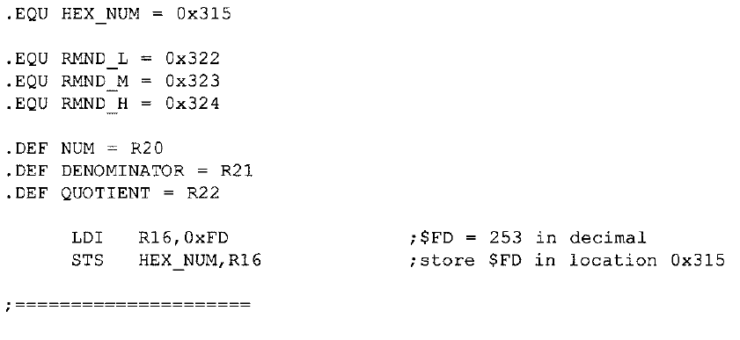
Example 5-8 (1/2)

Slide 27
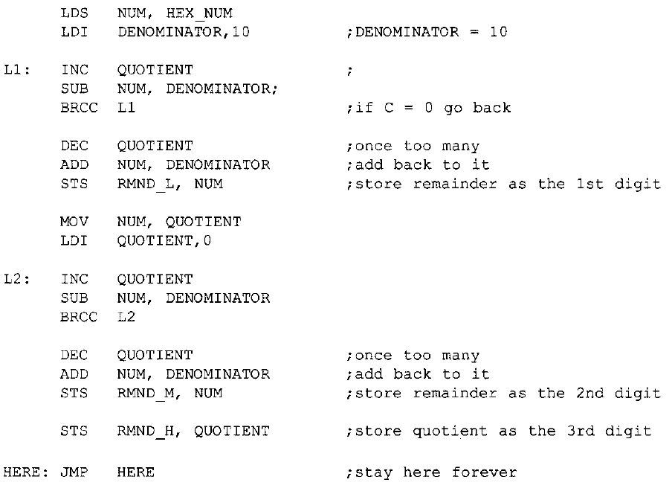
Example 5-8 (2/2)

Slide 28
Example 5-9
Analyze the program in Example 5-8 for a numerator of 253.
Solution:
To convert a binary (hex) value to decimal, we divide it by 10 repeatedly until the quotient is less than 10. After each division the remainder is saved. In the case of an 8-bit binary, such as FDH, we have 253 decimal, as shown below.
Quotient Remainder
253/10 25 3 (low digit)
25/10 2 5 (middle digit)
2 (high digit)
Therefore, we have FDH = 253.

Slide 29
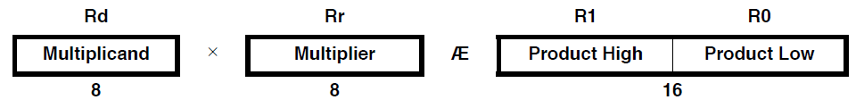
Data Processing: Arithmetic-FMUL
Fractional Multiply Unsigned : FMUL Rd, Rr
  R1:R0 ← Rd x Rr ; unsigned(1.15) ← unsigned (1.7) x unsigned (1.7)
  where 16 ≤ d,r ≤ 23
This instruction performs 8bit x 8 bit → 16bit unsigned multiplication.
The multiplicand Rd and the multiplier Rr are two registers containing unsigned numbers.
The 16 bit unsigned product is placed in R1(high byte) and R0(low byte).
Flags affected : Z, C
CPU Cycle : 2
  Example :
MUL R5, R4 ;Multiply unsigned R5 and R4
MOV R5, R1
MOV R4, R0 ;Copy result back in R5:R4
→
Let (N.Q) denote a fractional number with N binary digits left of the radix point, and Q binary digits right of the radix point.

Slide 30
FMULS & FMULSU
FMULS Rd,Rr where 16 ≤ d, r ≤ 23
R1:R0 ← Rd x Rr
signed (1.15) ← signed (1.7) x signed (1.7)
FMULSU Rd,Rr where 16 ≤ d, r ≤ 23
R1:R0 ← Rd x Rr
signed (1.15) ← signed (1.7) x usigned (1.7)

